Slide 1
INTRODUCTION
Embedded ubiquitous devices have revolutionized our day to day life. Most of these devices are based on microcontrollers and low end processors. The rise in use and variety of such embedded systems is driven by the fact that microcontrollers and low end embedded processors are cheap, easy to program using well defined programming models, and provide great flexibility in design and function of embedded systems.

Slide 2
Technical Approach
System Architecture
Figure 1 shows the overall system architecture. Figure 1(a) depicts the target system consisting of a MMUless MIPS R3000 processor simulator, having a fixed amount of RAM. The chracterstics of RAM (or local memory) is that it is fast (in terms of access time) and small (in terms of size). The processor is connected to a secondary storage device using an I/O interface. Two types of I/O interfaces are possible, namely, serial and parallel. The characteristics of secondary storage is that it is slow (in terms of access time) and large (in terms of size). The target system can have different architectures depending on the combination of I/O interface and the type of secondary storage.

Slide 3
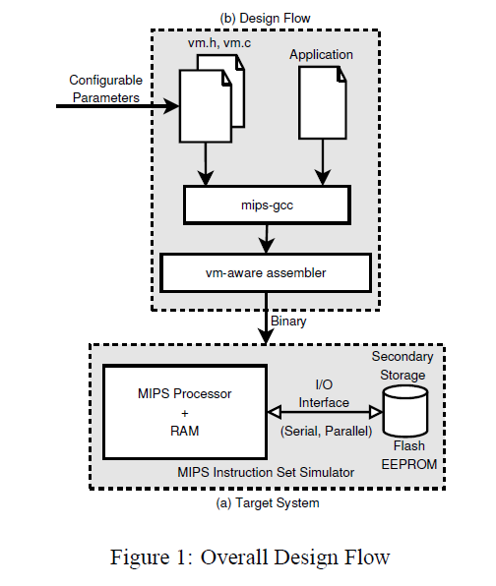

Slide 4
INPUT
1. The application source code. Note that, application’s view of address space is as large as the secondary storage i.e., the virtual address space.
2. The virtual memory library. This library consists of an implementation of virtual to physical address translation (vm.c). It also includes a header file (vm.h) with configurable parameters (page size, ram size), details of which are explained later in this section.

Slide 5
CONVERSION
We use mips-gcc (version 3.2.1) to compile the application, along with virtual memory library, and generate an assembly output. The generated assembly code, serves as the input to the vm-assembler.
The vmassembler inserts additional code that is responsible for runtime virtual to physical translation.
The generated binary, directly runs on our MIPS instruction set simulator (i.e., without the support of any underlying operating systems).

Slide 6
Mathematical Model
S={Ap ,Vml ,Vmh ,Pt ,Sem, }
Ap :-Application Source code
Vml :-Virtual Memory Library(logical ->Physical)
Vmh :-Virtual Memory Header(Ram & Page size)
Pt:-Page Table

Slide 7
Transition Operations
F1(Ap,gcc)->Asc
where gcc-compiler
Asc-Assembly Code
F2(Asc,Vmw)->Bin
where Bin-Binary generated
F3(Bin,Mip_sim)->Vi
where Vi-Virtual Address
F4(Vi,Pt)->Pi
Pi-Physical Address

Slide 8
Success & Failure
Success:-
Binary i.e. executable program for the Target System has been successfully generated.
Failure:-
1)Pure Virtualization.
2)Thrashing.

Slide 9
THANK YOU!!!!

